Slide 1
AdobeLife Social
FY22

Slide 2
Adobe has a thriving community of 60M followers and subscribers across all social platforms.
#AdobeLife accounts for 3.466M of those followers across our channels.

Slide 3
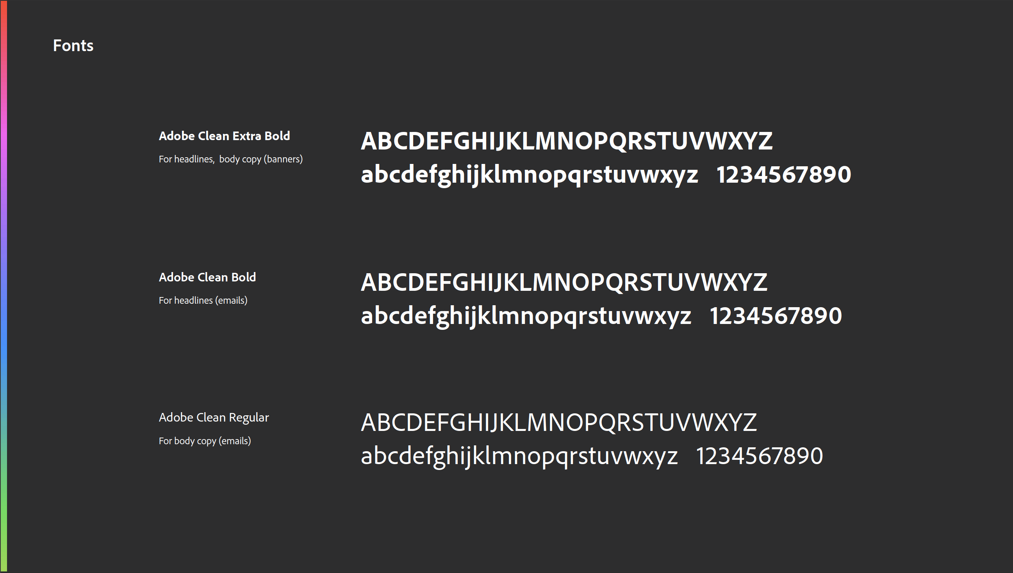


The State
Of Social
4.33B active social media users
55% social media users as a percentage of global population
2 hours 30 minutes average time spent per day on social media
99% percentage of social media users access via mobile device
*stats via Hootsuite & We Are Social study, April 2021
©2021 Adobe. All Rights Reserved. Adobe Confidential.

Slide 4
Social is always evolving.
If we don't lead, we risk falling behind.
The massive shift to
video first
Influencers, platforms, & decision making
1:1 connections/
community programs
81% of US adults use YouTube
TikTok topped 3 billion installs
Head of Instagram says it’s now an entertainment & video platform
More than half of Internet users say social influences their decision making
53% of Gen-Z use social more than search to research brands
People are more likely to trust friends, family, and social influencers than brands
Niche communities are being built on Discord, Twitch, and TikTok
CSR and social justice initiatives drive continued impact on corporate reputation and attracting top talent.
©2021 Adobe. All Rights Reserved. Adobe Confidential.

Slide 5

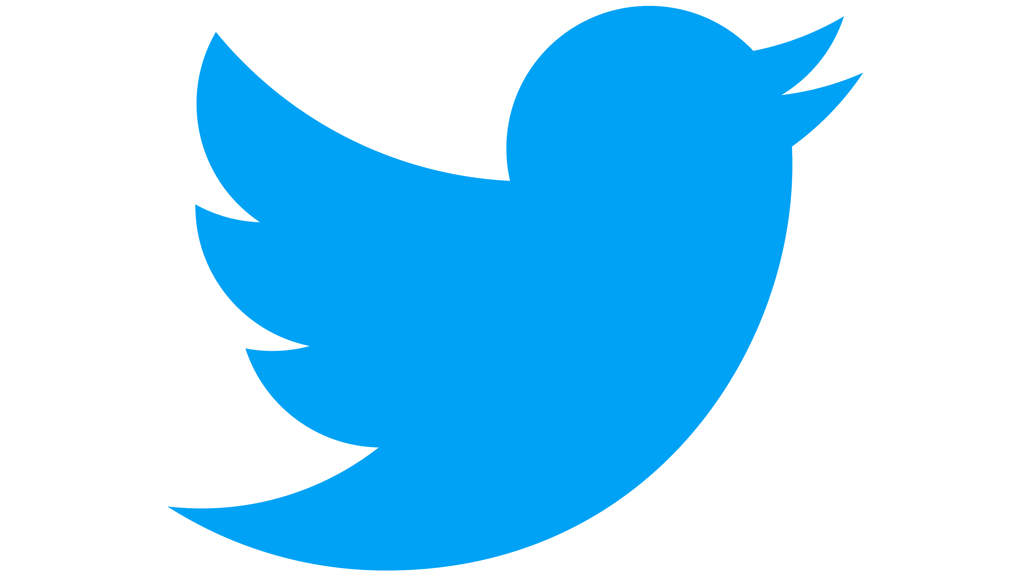











AdobeLife operates
20+ social channels
On all 6 major platforms
Ranging from (@adobe, @Adobecareers, @AdobeLife, @AdobeUK, @AdobeArmenia, @AdobeResearch, etc)
©2021 Adobe. All Rights Reserved. Adobe Confidential.

Slide 6
Where We’re Going
Past
Evolving to...
Last-Touch Marketing Support
Product/Careers-Centric Messaging
Inconsistent Social KPIs & Reporting
Reactive Social Listening
Disparate Community Management
Social-First Programs (AKA Made-For-Platform Content)
Audience-Centric Messaging with Product/Careers Integration
Streamlined Social Measurement Framework
Integrated, Full-Funnel Approach to Paid Social
Candidate-Driven, Proactive Social Intelligence
Centralized Community Management & Engagement
©2021 Adobe. All Rights Reserved. Adobe Confidential.

Slide 7
Our momentum

Slide 8
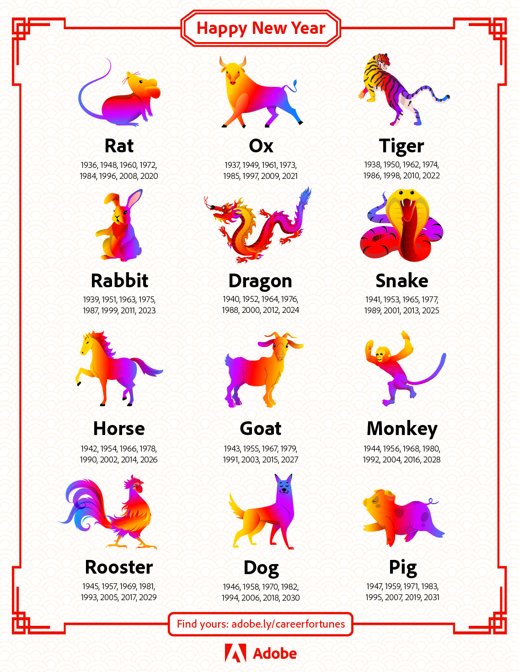
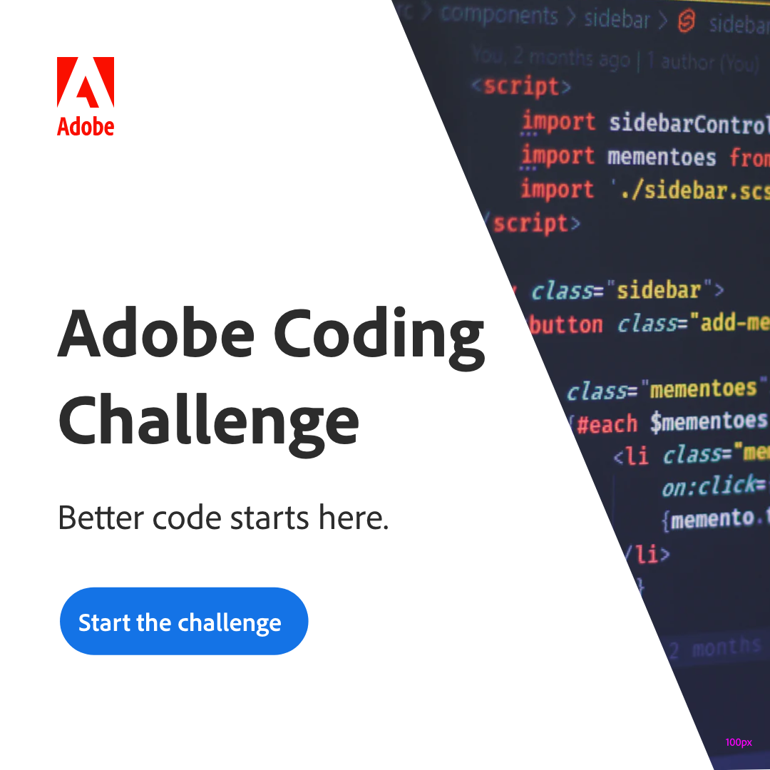
We’re cementing
Adobe's cultural
relevance.
We’ve built a
Social Newsroom
We leverage social listening and pop culture trends to participate in real-time, relevant conversations
©2021 Adobe. All Rights Reserved. Adobe Confidential.

Slide 9
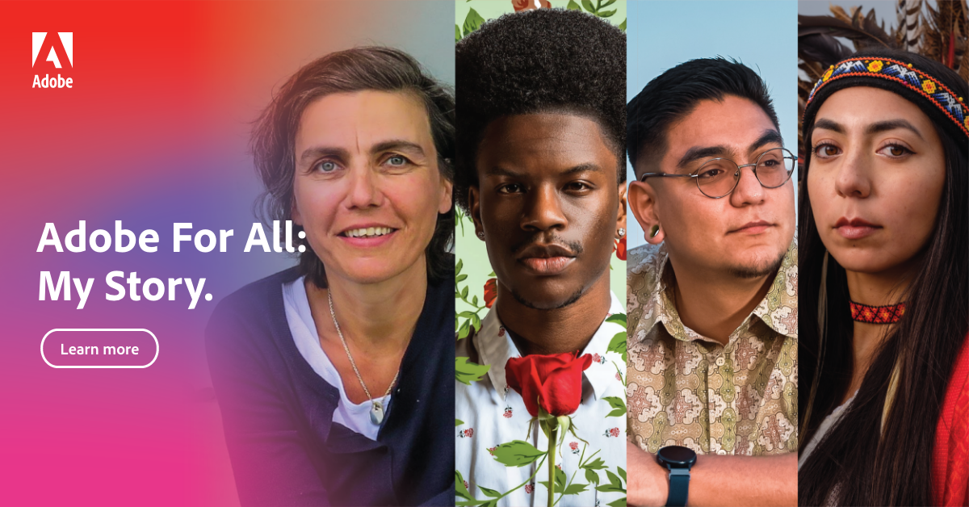
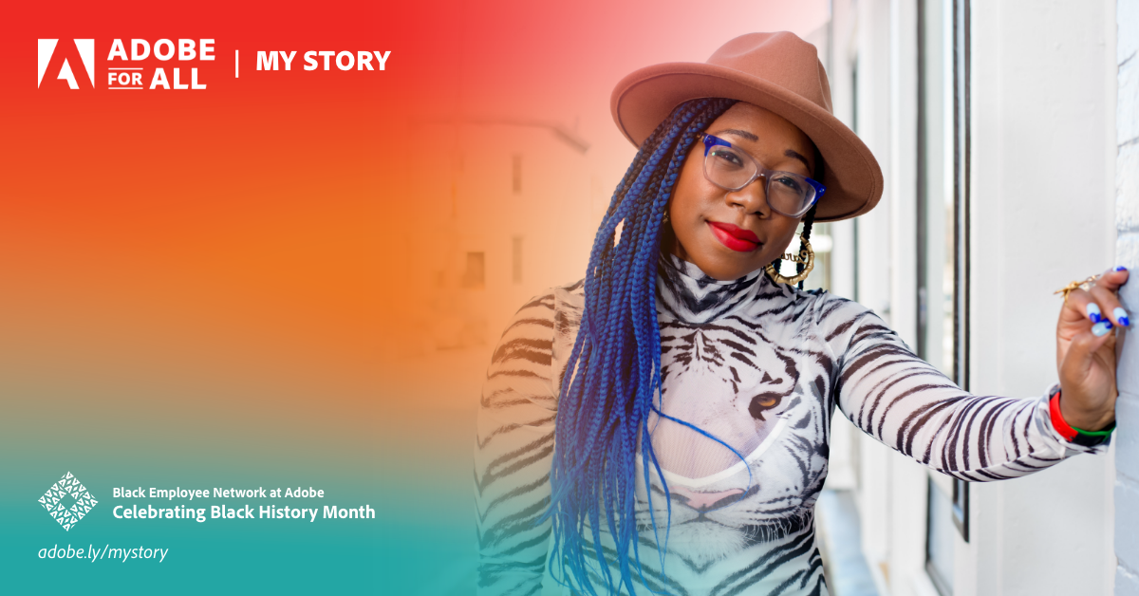
We’re empowering
our employees.
We represent Diverse Voices
We drive this messaging through programs like Adobe For All: My Story, BEN at Adobe, and more cultural moments.
©2021 Adobe. All Rights Reserved. Adobe Confidential.

Slide 10



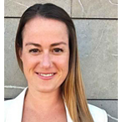




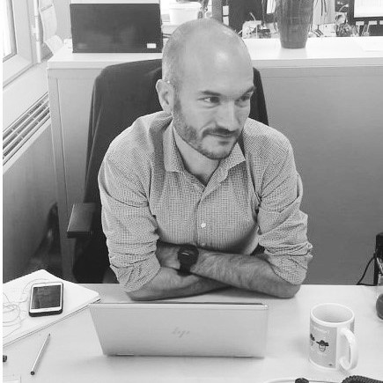

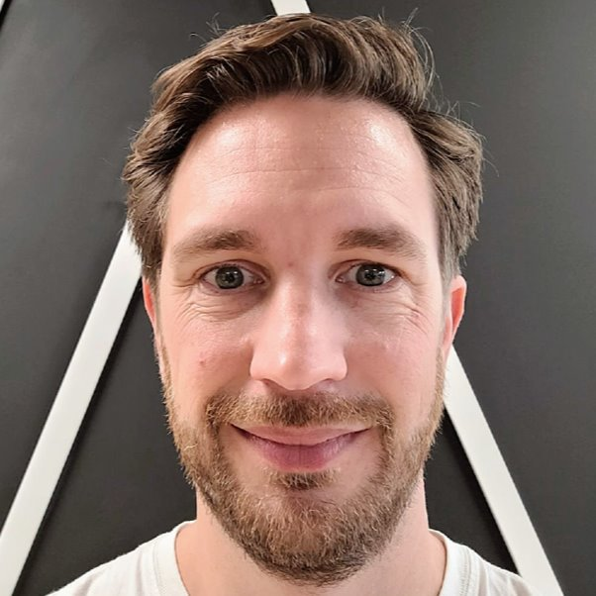
We’re empowering
The Talent team.
We brought Talent Partners
into an Advisory Board
Hideaki Takao
Talent Marketing Lead, Japan
(20% of time)
Ariadna Stamatopol
Talent Marketing Lead, Romania
(20% of time)
Imane Addou
Talent Marketing Co-Lead,
Western
(20% of time)
Barbara Allaert
Talent Marketing Lead, Germany
(20% of time)
Charles Hide
Talent Marketing Lead, UK & Ireland
(20% of time)
We’ve partnered with a group of Talent Partners and Comms partners who react to and advise us on our social programs.
Sarah Onishi
Talent Marketing Lead, Japan
(20% of time)
Aida Ciolache
Talent Marketing
Program Manager,
Romania
(20% of time)
Madalina Nitu
Talent Marketing
Program Manager,
Romania
(20% of time)
Julien Chevalier
TA Manager, Western
Max Malsy-Mink
TA Manager, Germany
Ollie Hayes
TA Manager, UK & Ireland
©2021 Adobe. All Rights Reserved. Adobe Confidential.

Slide 11



We’re empowering
hiring teams & employee influencers.
We’ve ramped up employee influencers via
Hiring toolkits
Hiring toolkits and micro trainings brings influential global employees to highlight key Adobe moments like MAX, Adobe for All Summit, and Summit.
We’ve partnering with hundreds of employees at all levels of seniority to push this forward. Employee influencers typically drive more than a 35% increase of qualified application and social interactions through their efforts.
©2021 Adobe. All Rights Reserved. Adobe Confidential.

Slide 12
We are expanding audiences through strategic partnerships.
YouTube Brands As Creators
LinkedIn Brand DNA Strategy
Goal: Create a prominent voice on YouTube driven by an always-on content strategy that drives significant growth in earned & organic viewership.
Goal: Unify our brand messaging on LinkedIn across Talent, corporate, and consumer teams.
©2021 Adobe. All Rights Reserved. Adobe Confidential.

Slide 13
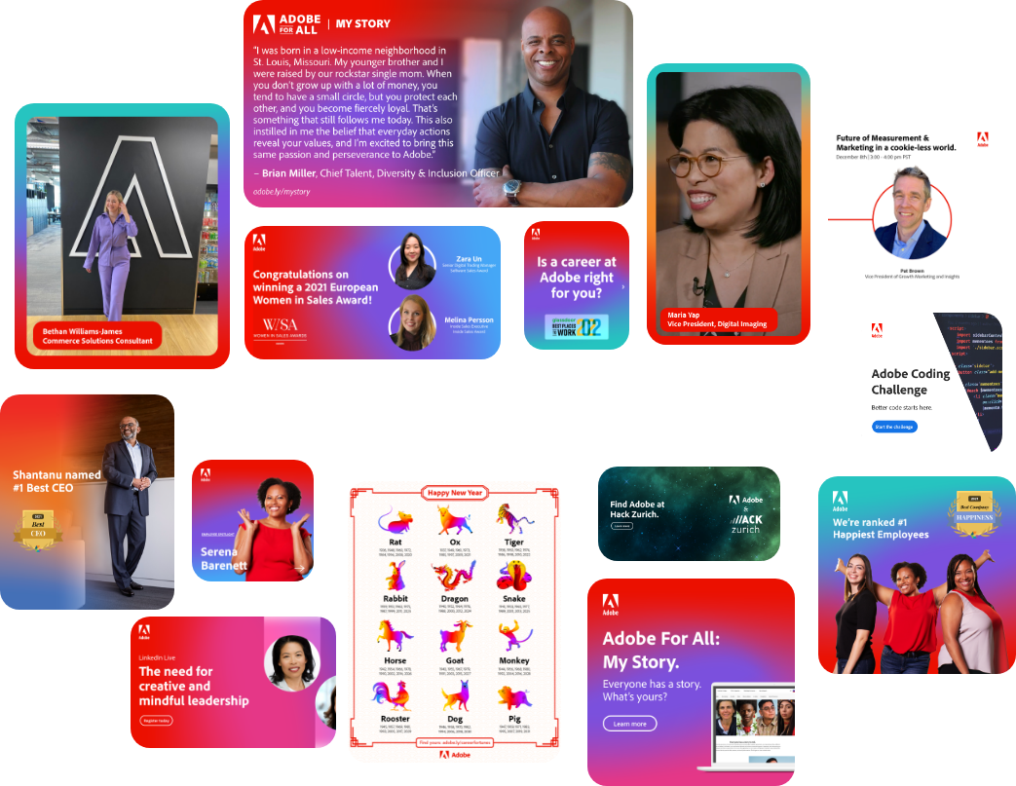
Social doesn’t exist in silos, and neither should we.
Social is now the heartbeat
of all marketing activities
Notes:
Social is now at the intersection of all marketing activities.

Slide 14
Social is the
heartbeat of marketing
Social is now the heartbeat
of all marketing activities
Notes:
Social is now at the intersection of all marketing activities.

Slide 15
Events Planning
Company
Awards
Real Time & Trending Topics
Employer Brand Awareness
Social Messaging
Social is the
heartbeat of marketing
Paid Social
Cultural Moments
Social-First Programs
Engagement & Retention
Community Management & Engagement
Notes:
Social is now at the intersection of all marketing activities.

